Slide 1



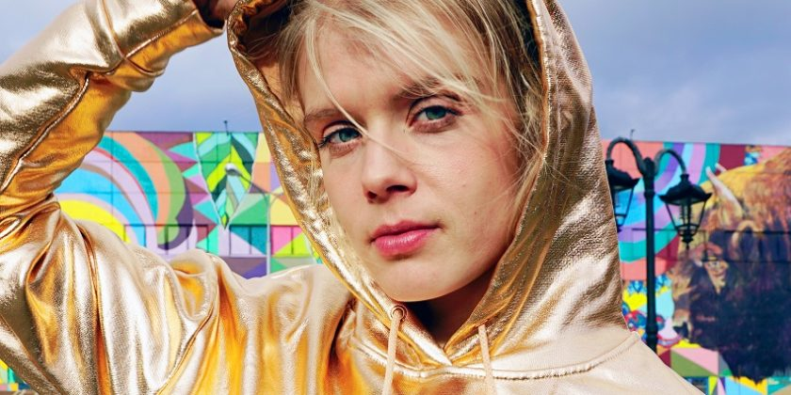

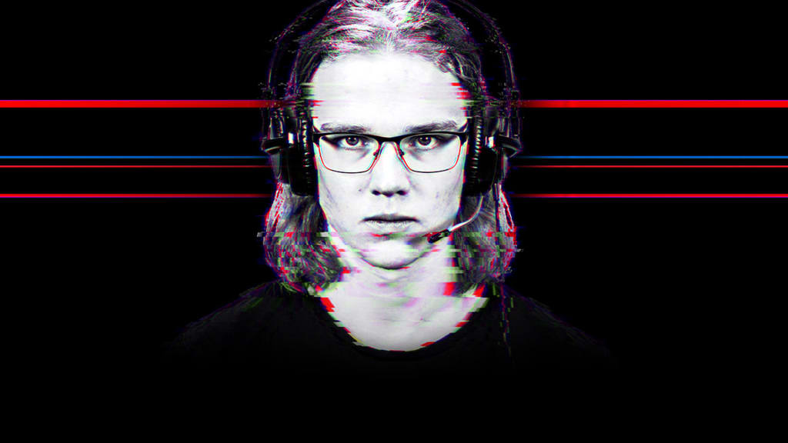
DATA AND USER INSIGHTS
FOR CREATION AND DEVELOPMENT
Raimo Lang
raimo.lang@yle.fi
+358408307990
27092018

Slide 2
Content Probes as a methodology:
Systematic mix of science and artistic observation
Data for creation
Data for evaluation
Inspiration
Subjective
Relevance
Small signals
Interpretation
Personal
Truth
Collective
Objective
Measuring
Logic
Transparent

Slide 3
Content Probes as a methodology:
Systematic mix of science and artistic observation
Writers observation
Content Probes
Science
Inspiration
Subjective
Relevance
Small signals
Interpretation
Personal
Inspiration
Subjective + Collective
Relevance
Small signals
Interpretation
Personal+Transparent
Truth
Collective
Objective
Measuring
Logic
Transparent

Slide 4
I could have been watching this two years ago when it was ok for me that there is no more profound matter behind this story.
Now, there needs to be something that gets to feel something I haven’t felt before or to think something I haven’t thought before.
Isabella, 15 years (citation from user workshop 11/17)

Slide 5
WE HAVE TO ADMIT
1
We do not automatically understand generation 20-29y life, needs, media preferences and media usage
2
Even young makers do not have a full access to understand their generation
3
So, we need complitely new approach and method

Slide 6
PUBLIC SERVICE LEGITIMATION IS ALL ABOUT RELEVANCE
RELEVANCE ?
PEOPLE FIND + WATCH + LIKE + SHARE WHAT YOU PRODUCE
Notes:
I THINK AND I HOPE WE SHARE THE SAME BATTLE
BATTLE FOR RELEVANCE + LEGITIMATION + APPRECIATION – ALSO AMONG 15-30 AND 30-45 YEARS OLD WHO’LL DECIDE OUR FUTURE

Slide 7
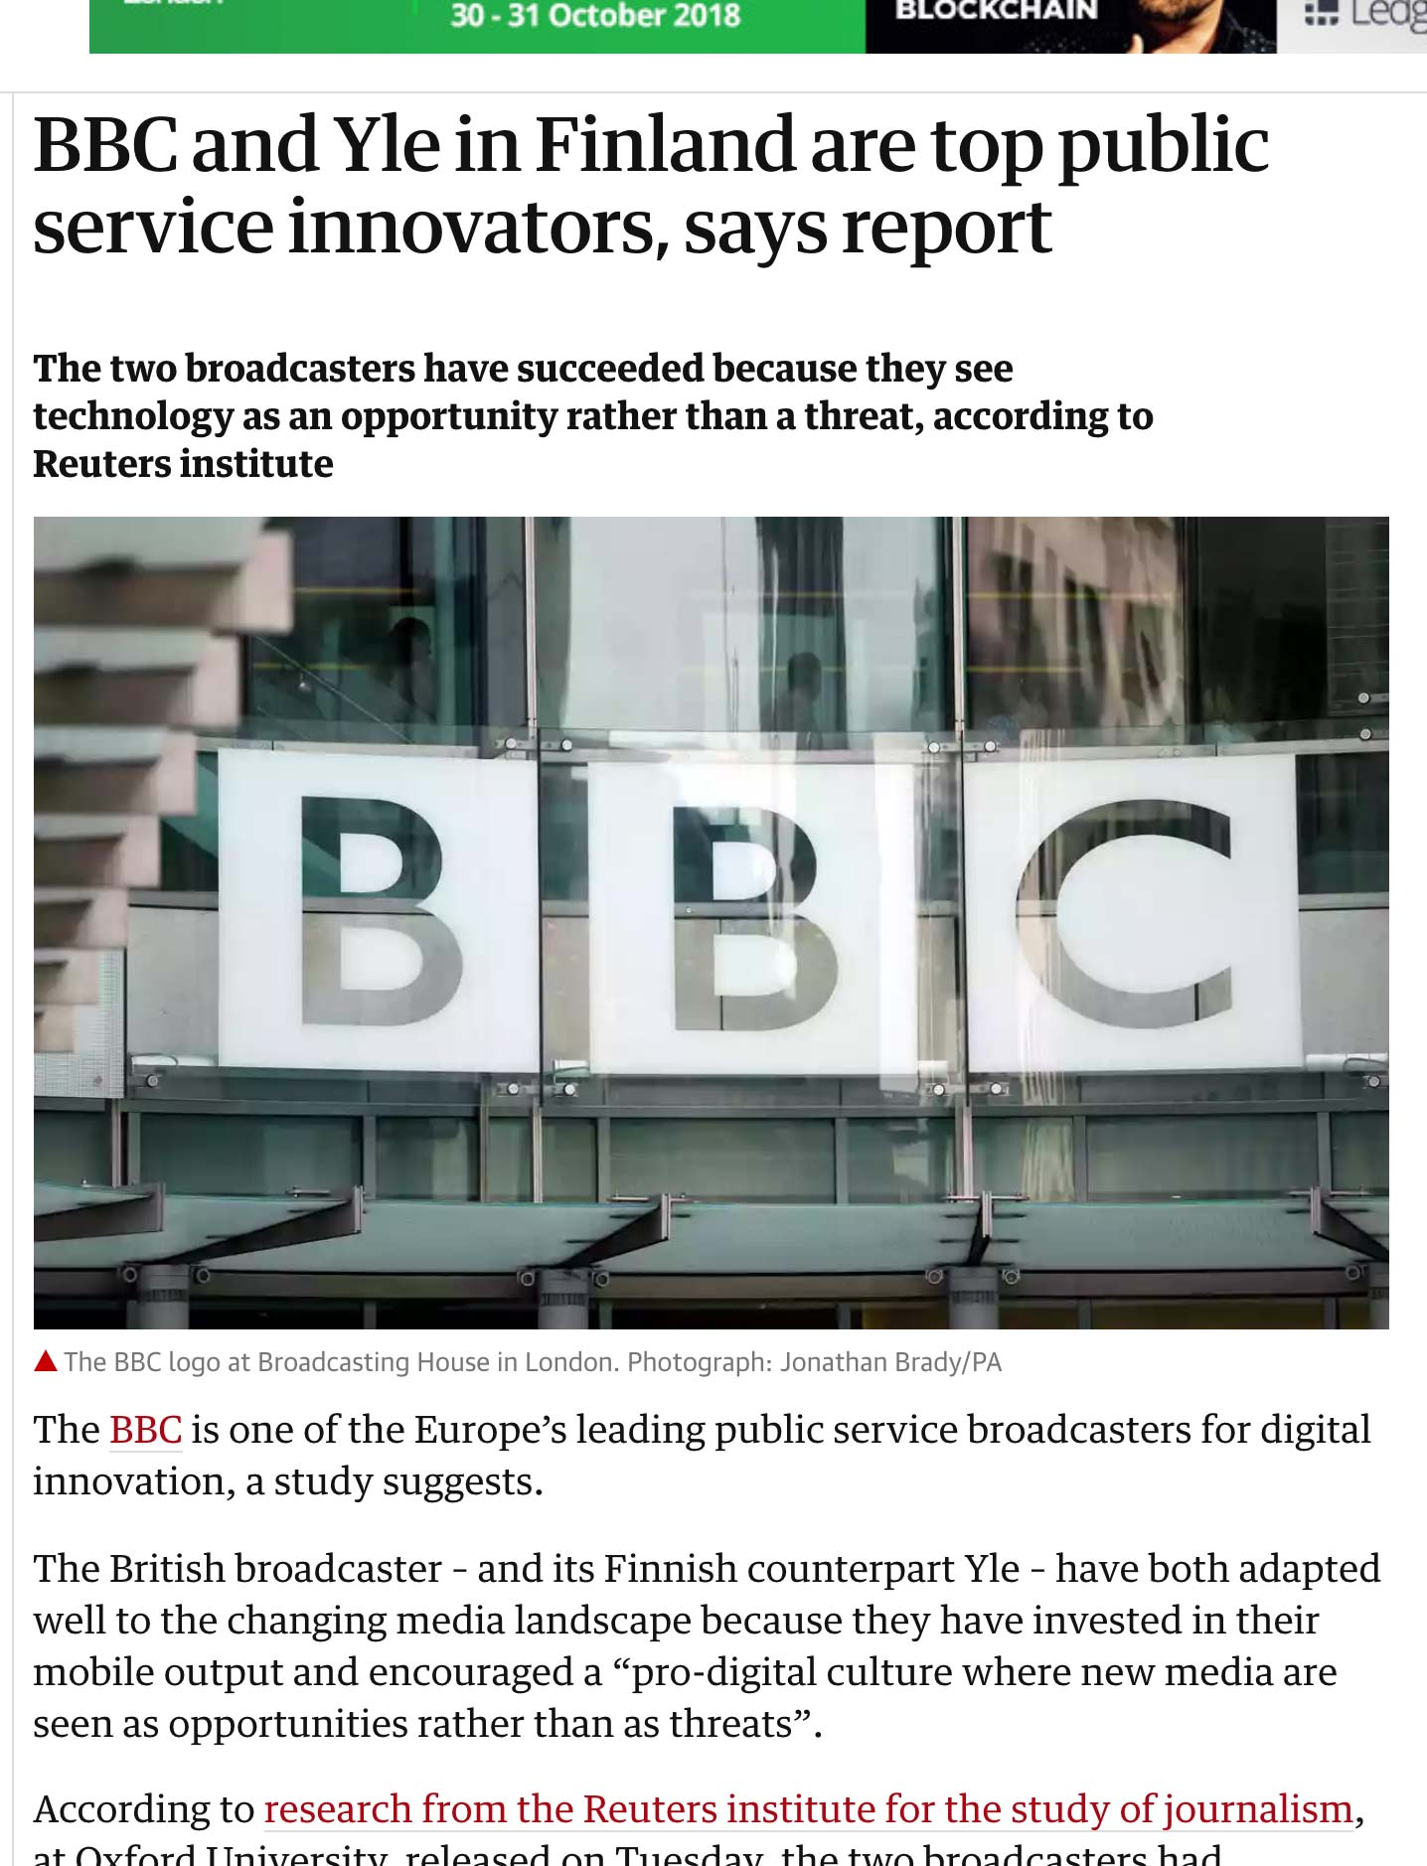
Notes:
VOD service opened 2007, VOD catalog publishin 2015 both first or near first in Europe

Slide 8
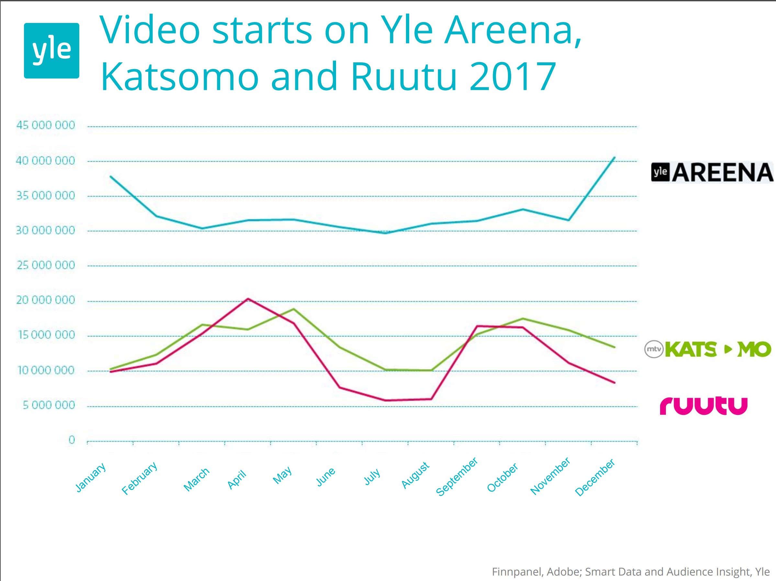

Slide 9
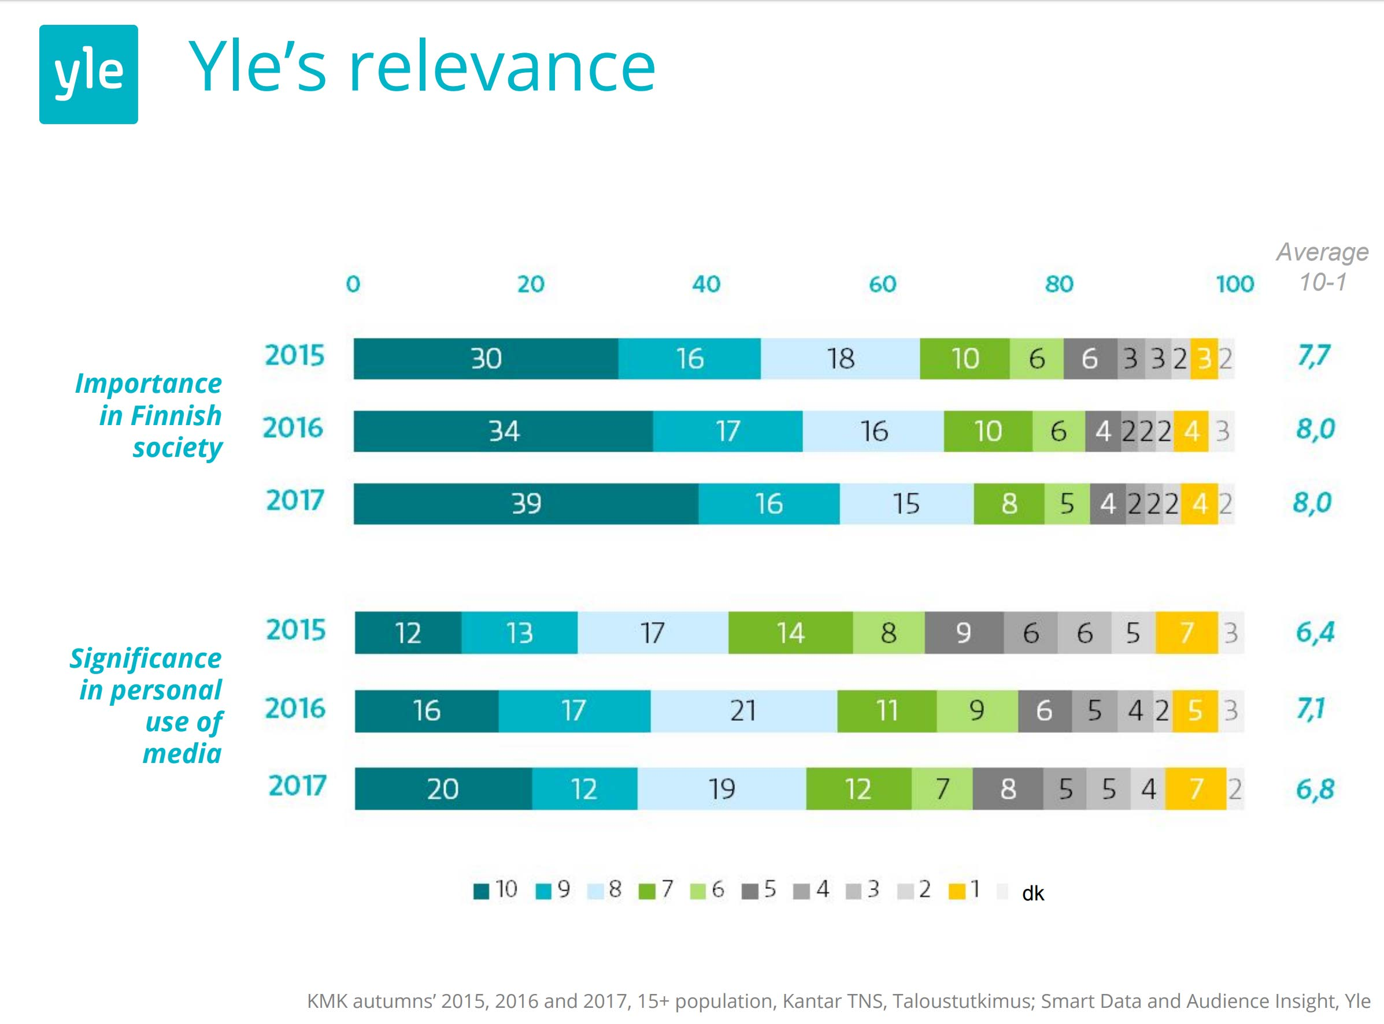

Slide 10
LOOKING BACK :
DATA SCIENCE
/ ANALYTICS
OF OUR CONTENT
- FOR MANAGERS & LEGITIMATION

Slide 11
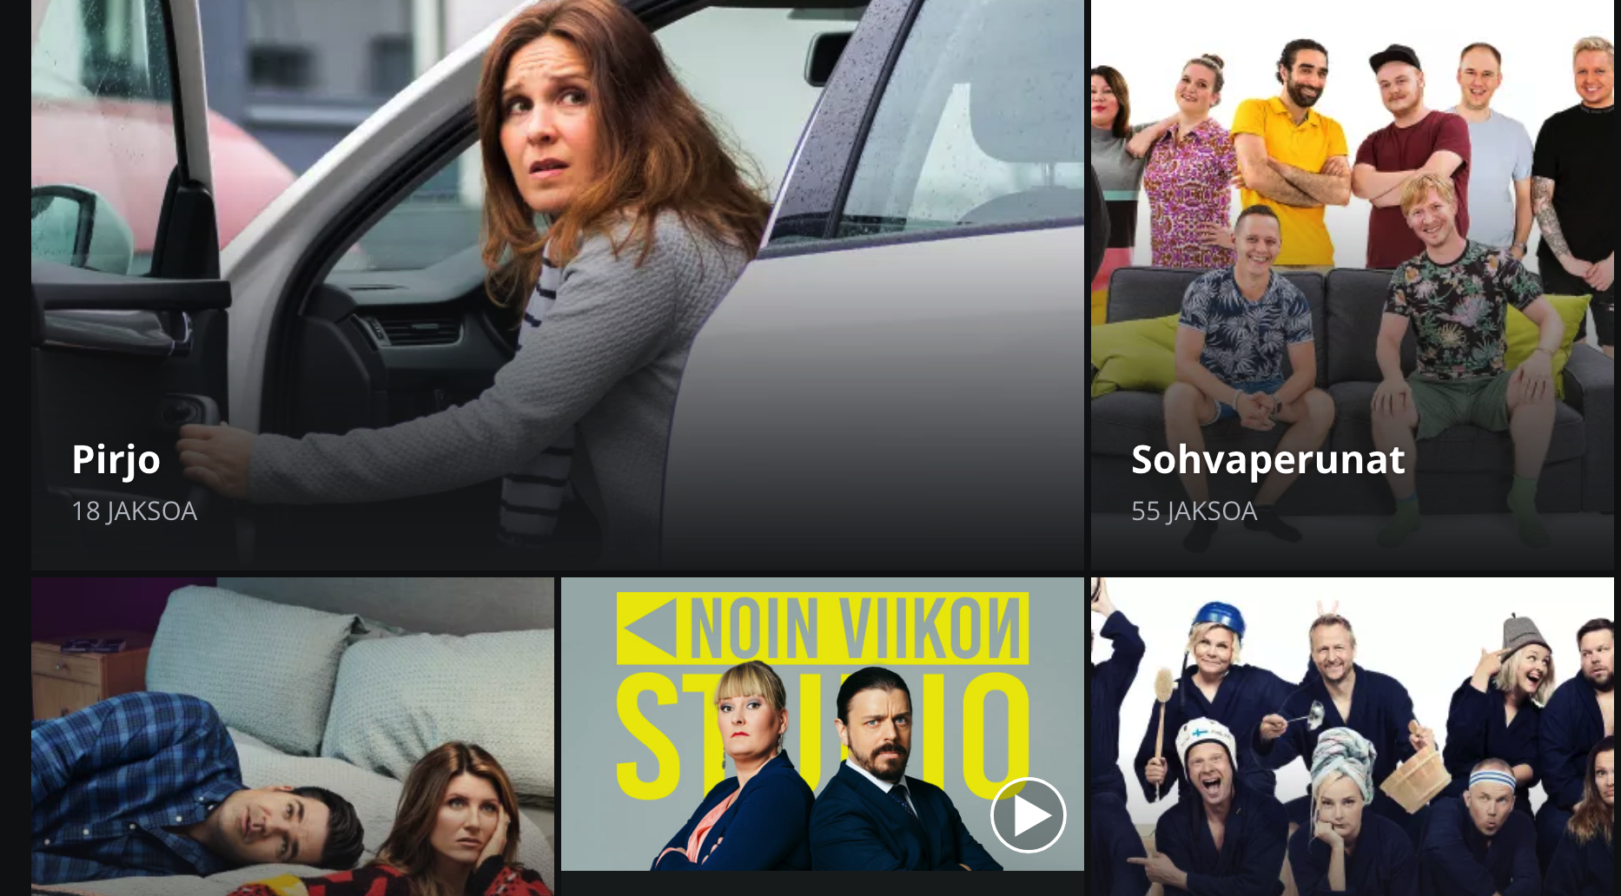
Viihteen verkkodataa 2018
Tapahtumat, katalogiviihde ja studioviihde

Slide 12
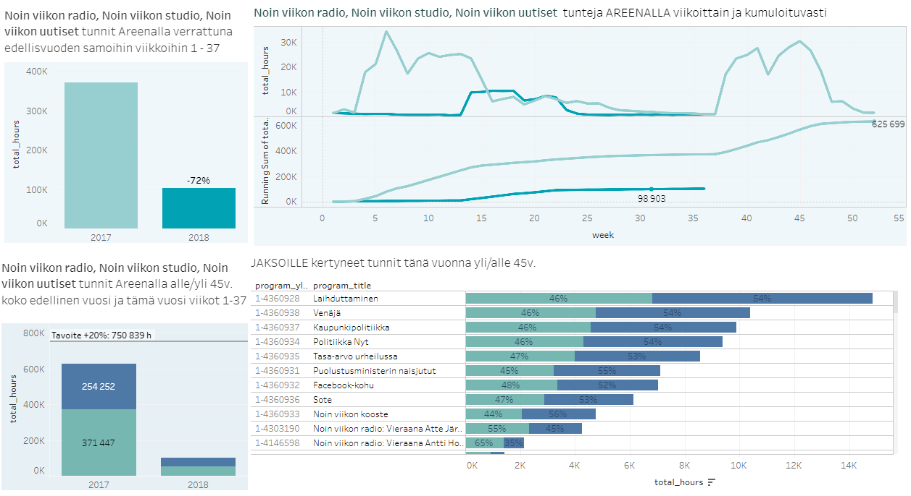
Noin viikon studio
Noin viikon studio ei ole kivunnut Noin Viikon uutisten tuottamiin lukuihin.
2018
2017
Yli 45v
Alle 45v

Slide 13
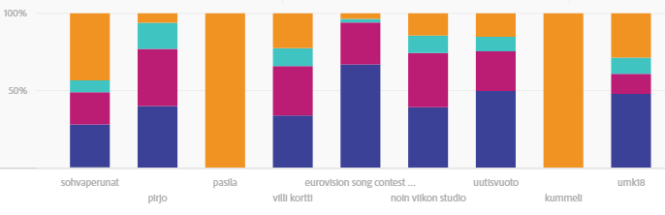
Katseluiden etäisyys julkaisusta
Ensimmäisen viikon aikana tulee huomattava osa produktion katseluista (tummansininen ja violetti alla olevassa kuvassa).
Tapahtumien kuten Euroviisujen kohdalla huomataan, että käyttö on hyvin julkaisuajankohtaan sidottua.
Myös studioviihdettä kulutetaan enemmän lähellä julkaisuajankohtaa (Uutisvuoto, Noin viikon studio)
Pirjon kohdalla samaa päätelmää ei voi vielä tehdä, koska julkaisusta on vasta hieman yli 2 viikkoa.
Videon aloituskertojen osuus Areenassa suhteessa julkaisuaikaan
Yli 2vk
8-14 päivää
2-7 päivää
0-1 päivää
14.9.2018
Luovat sisällöt/Erno Paunonen
13

Slide 14
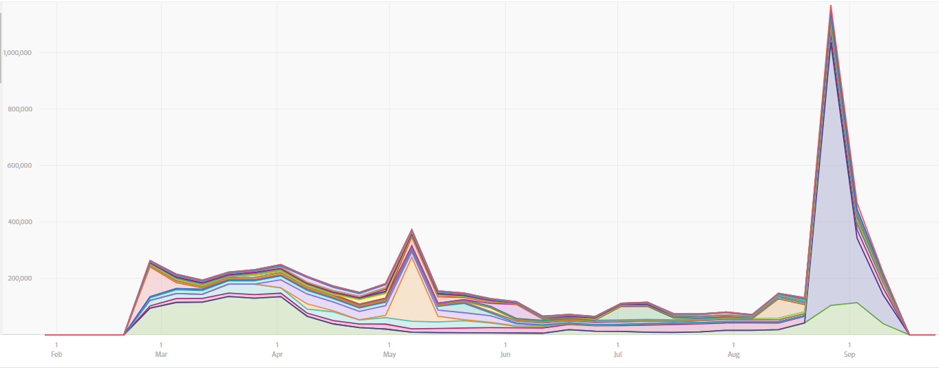
Videoiden aloitukset kulttuurin ja viihteen top 25 produktioihin
Aloitusten määrä
Pirjo
UMK
Noin viikon studio
Euroviisut
Sohvaperunat
Sohvaperunat
Pasila
Studio Julmahuvi
Ruisrock
14.9.2018
Luovat sisällöt/Erno Paunonen
14

Slide 15
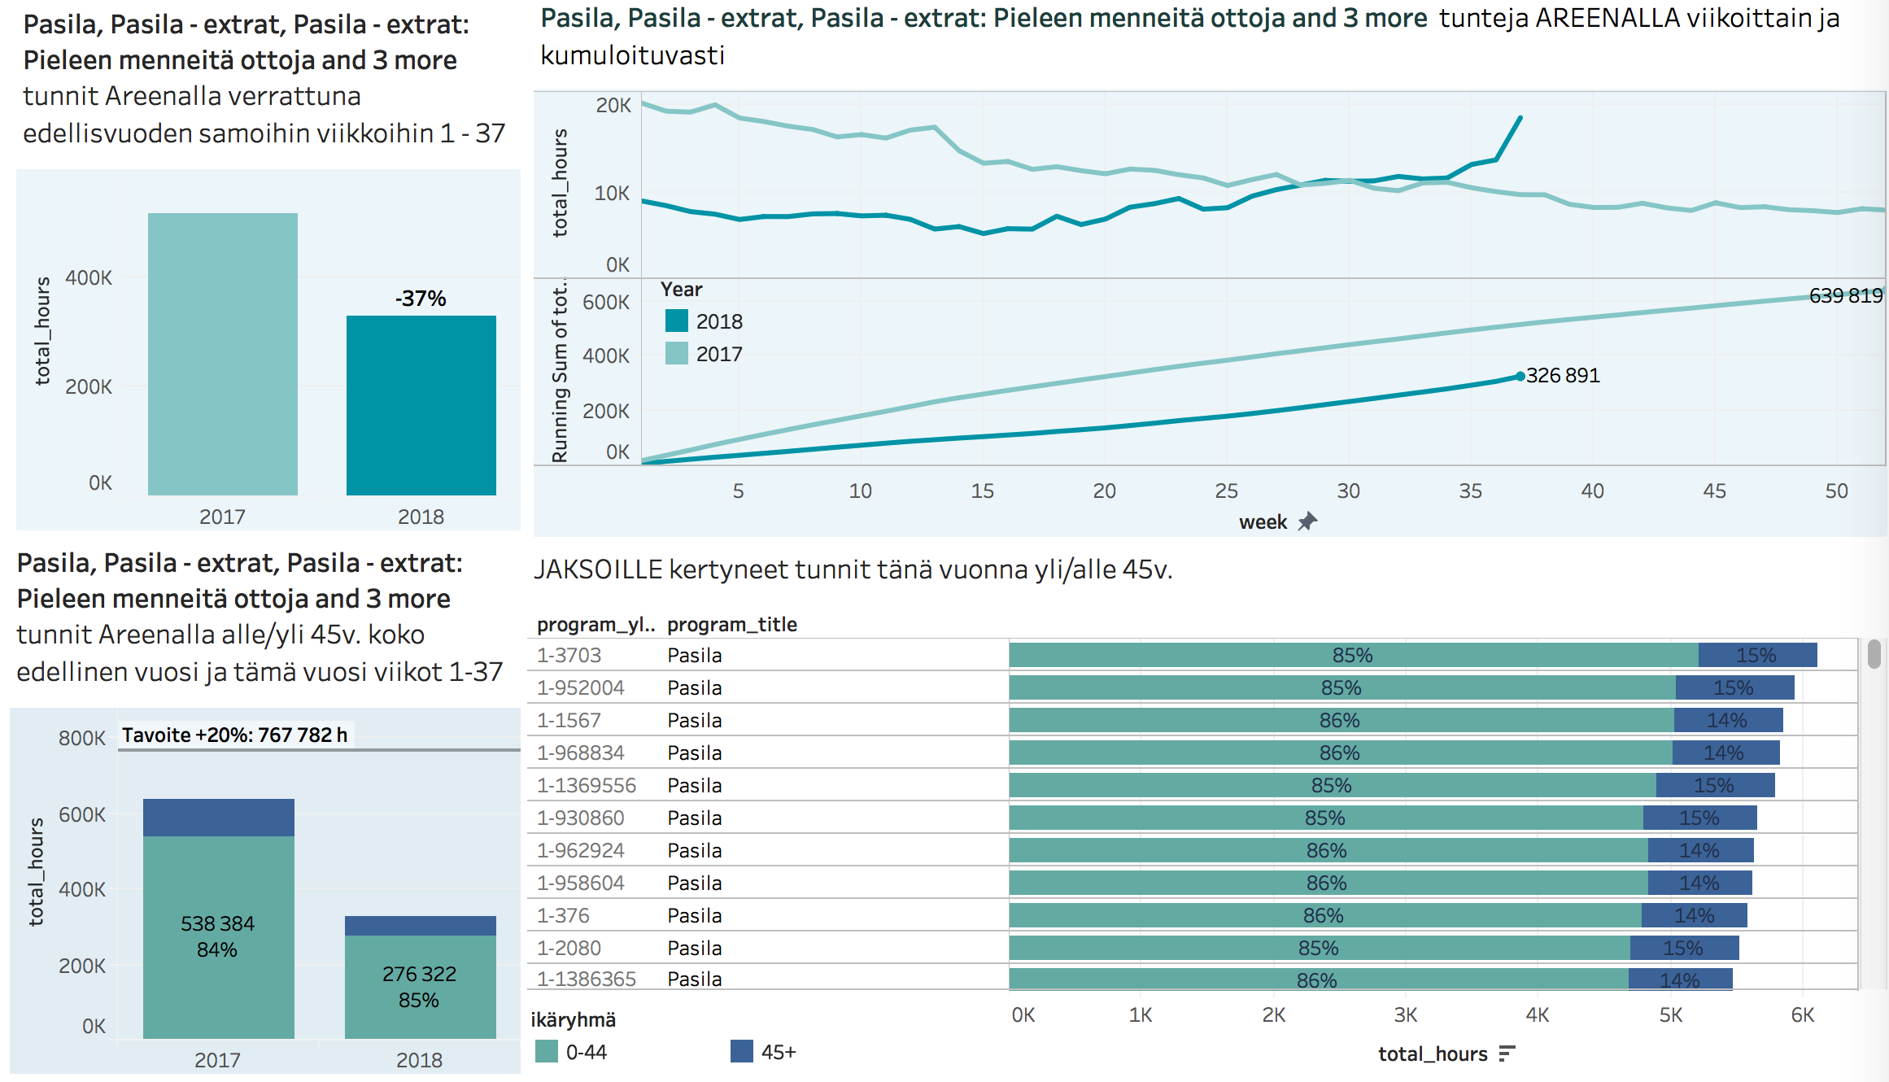
About Pasila animation catalog
2018
2017
Pasila on ollut katalogissa pitkään, silti tunteja kertyy edelleen merkittävästi. Katselu kääntynyt jälleen nousuun. Katseluprofiili on nuori.
Yli 45v
Alle 45v
14.9.2018
Luovat sisällöt/Erno Paunonen
15

Slide 16
Viihdeohjelmat verkossa
Tapahtumaviihde
UMK, Euroviisut, Nenäpäivä
Pitkäjänteisesti rakennetut transmediaiset tapahtumat elävät jo verkossa.
Tuottavat isoja kävijäpiikkejä yksittäisille viikoille
Pelkkä stream Areenalla ei riitä, vaatii rinnalle hyvää tapahtumallistamista ja osallistamista verkossa ja IRL
Katalogiviihde
Pasila, Kummeli, Sohvaperunat
Huumori on investointi tulevaisuuteen.
Pasila jälleen nosteessa. Animaatioklassikko löytää uusia nuoria sukupolvia.
Sketsisarjat kestävät aikaa ja kypsyvät ajan myötä jopa klassikoiksi. (Kummeli, Siskonpeti, Velipuolikuu)
Realitymaiset viihdetuotannot, joissa vahvoja persoonia tai ihmistarinoita toimivat myös katalogissa. (Sohvaperunat, Suomi Love). Uusien kausien julkaisu tuo katselua edellisille.
Studioviihde
Noin viikon studio, Villi kortti
TV-viihteen näköinen viihde kerää katselua Areenalla useimmiten lähempänä lähetysajankohtaa kuin katalogissa
Osalle vielä broadcast-tv:n katselua täydentävää catch-up käyttöä
Muuttuakseen ilmiöksi myös verkkokatselussa vaatii hyvää somestrategiaa ja jatkuvia viraalihittejä
14.9.2018
Luovat sisällöt/Susanna Snell & Erno Paunonen
16

Slide 17
LOOKING FORWARD
USER INSIGHTS FOR INSPIRATION
- FOR PRODUCERS AND MAKERS

Slide 18
DESIGN THINKING
STANFORD UNIVERSITY 2005
EMPATHIZE
IDEATE
Human-centred innovation process guided by prototyping
DEFINE
PROTOTYPE
TEST
We found out that we had been working according design thinking principles

Slide 19
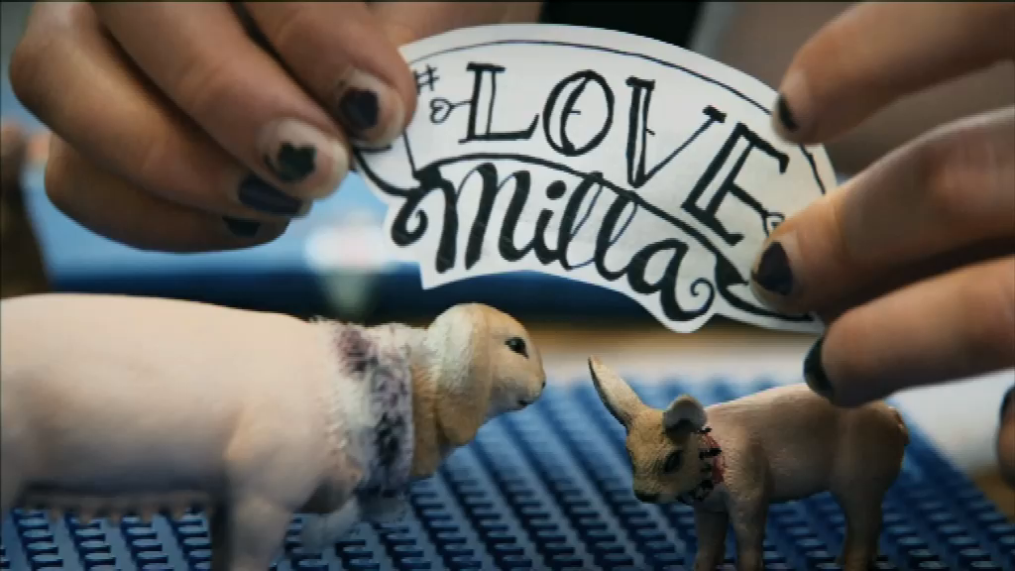
Notes:
#LOVEMILLA, OUR FIRST SUCCESS WITH 15-20 YEARS OLD – SUMMER 2013

Slide 20
FIVE CHANGES IN PARADIGM
90min or 8x30min
TV channel
One plot/story
One genre
Yle Marketing
26 (72) x 5-8min
VOD, youtube, IG
Cartoon strip type
Switching genres
Peer group marketing

Slide 21

EMPATHIZE
Get to know
the target audience you’re making the content for
through observing and interviewing.
Who is my user?
What does s/he care about?
I’m making a program
for a targeted
audience.
What are
those people like?

Slide 22
.. To create empathy and undestanding ..
CONTENT
PROBES

Slide 23
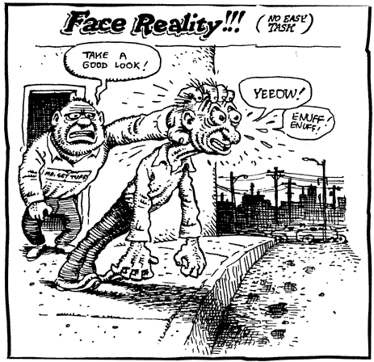
EASY: YOU KNOW WHAT YOU DON’T KNOW => YOU ASK
CHALLENGE: YOU DON’T KNOW WHAT YOU DON’T KNOW => HOW TO ENTER THE WHOLE MATTER?

Slide 24
The dilemma:
FILM IS NOT FELT RELEVANT
COMPETITORS
?
MAKER
FILM
VIEWER/USER

Slide 25
The dilemma:
MAKER IS LEANING TO TRADITION AND TASTE
COMPETITORS
DRAMA
DOCUMENTARY
TRADITION
?
MAKER
FILM
VIEWER/USER

Slide 26
The dilemma:
WE DO NOT SHARE THE SAME WORLD
COMPETITORS
DRAMA
DOCUMENTARY
TRADITION
?
MAKER
FILM
VIEWER/USER
Reality: experiences, habits, phantasies etc. ARE DIFFERENT!

Slide 27
The dilemma:
ASSUMPTIONS RULE
<
Makers assumptions about good professional practice
- What is good?
Makers assumptions how viewer/user thinks, feels, prioritizes, needs
COMPETITORS
DRAMA
DOCUMENTARY
TRADITION
?
MAKER
FILM
VIEWER/USER
Reality: experiences, habits, phantasies etc. ARE DIFFERENT!

Slide 28
Content Probe – promoting new understanding about our users/viewers
Things we think we know
Things we actually know
Things we actually do not know
Things we think we do not know

Slide 29
Where the danger lies? Why we need Content Probe –method?
Things we think we know
EXPLICIT PROFESSIONAL KNOWLEDGE
We know that we know
RATIONAL RESEARCH
We know what we do not know
Things we actually know
Things we actually do not know
SILENT KNOWLEDGE
We do not know what we know
SOURCE OF RADICAL CHANGE
We do not know what we do not know
Things we think we do not know

Slide 30
Enabling and catalysing new approaches and practise
Things we think we know
Audience understanding
Observation for fiction or factual
Plot and story developement
Character creation
Production design
Building audiovisual style
making content – for what device?
making content – for what usage?
EXPLICIT PROFESSIONAL KNOWLEDGE
We know that we know:
our work is based on this
RATIONAL RESEARCH
We know what we do not know: this is what normal research is directed
Things we actually know
Things we actually do not know
SILENT KNOWLEDGE
We do not know what we know: Silent knowledge, important all organizations
SOURCE OF RADICAL CHANGE
We do not know what we do not know:
this is the area where danger and possibilities come from!
Content Probe is a special method to attack this challenge by content makers and designers themselves
Things we think we do not know

Slide 31
Content Probes as a methodology:
Systematic mix of science and artistic observation
Writers observation
Content Probes
Science
Inspiration
Subjective
Relevance
Small signals
Interpretation
Personal
Inspiration
Subjective + Collective
Relevance
Small signals
Interpretation
Personal+Transparent
Truth
Collective
Objective
Measuring
Logic
Transparent

Slide 32
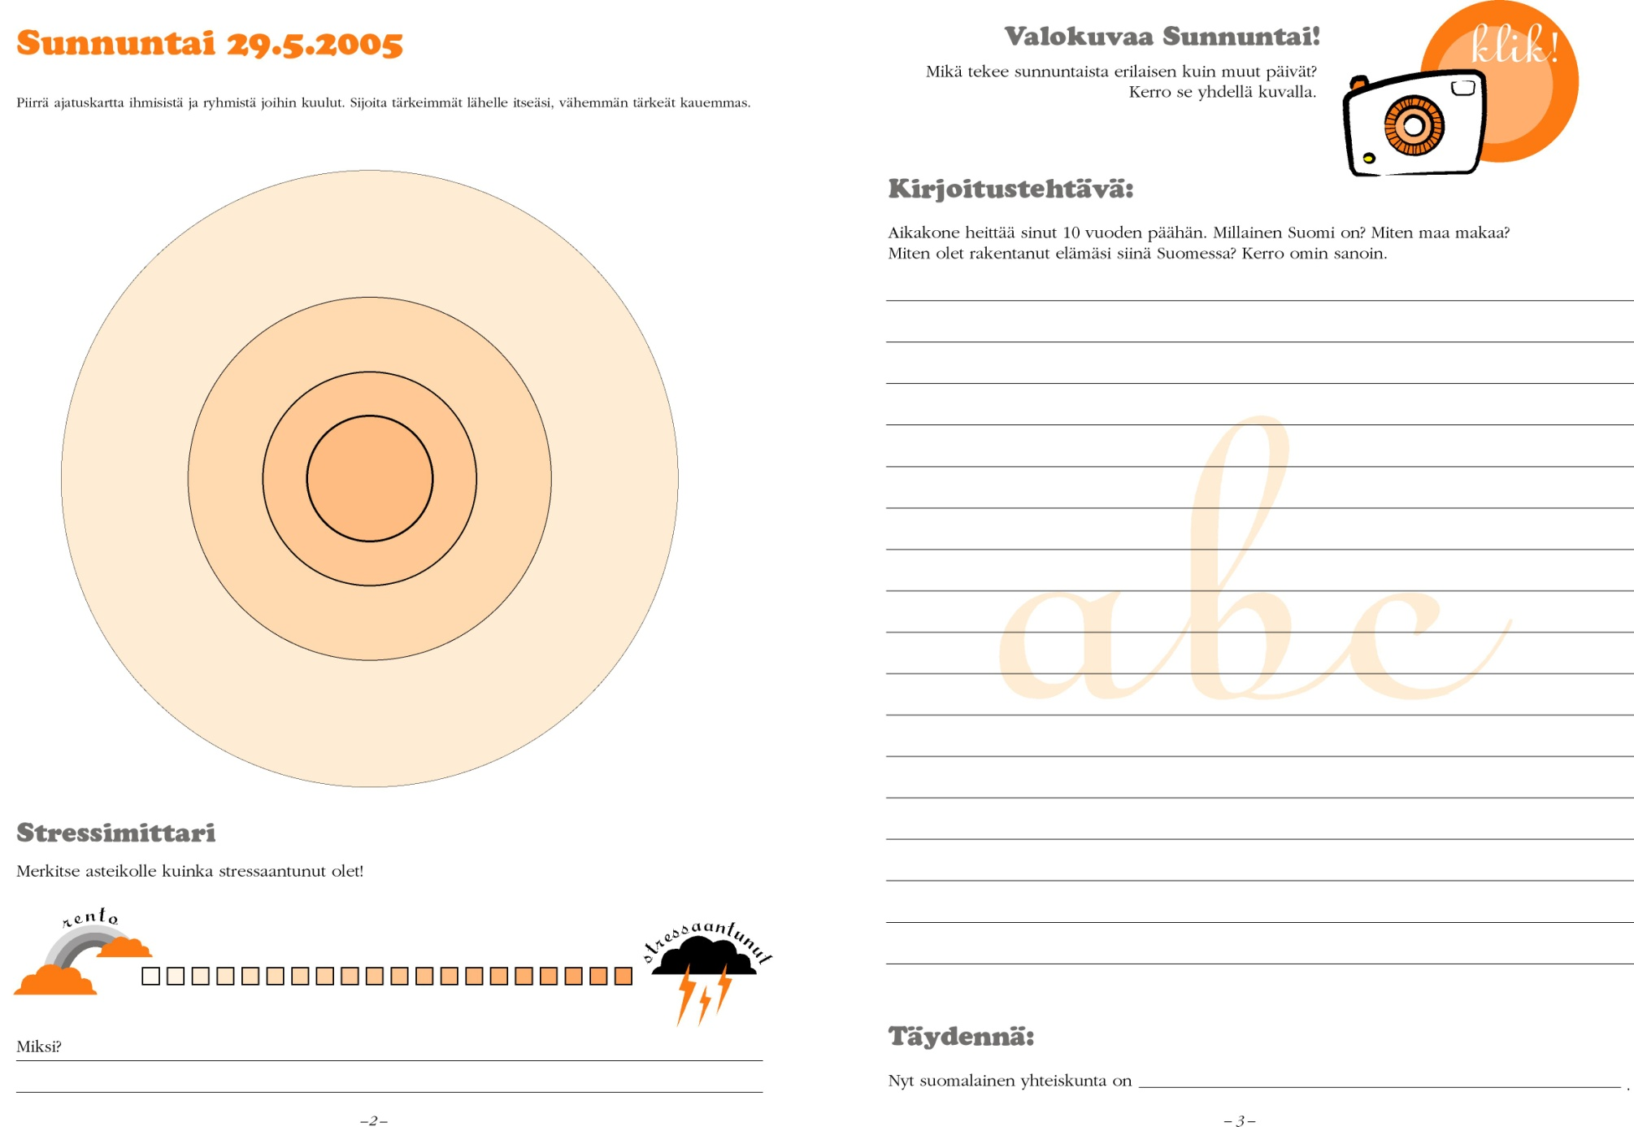
1
1.User insight projects –
’Settling down to hear’
Ajankohtaisohjelmien luotaintehtehtäväkirjasta
32

Slide 33
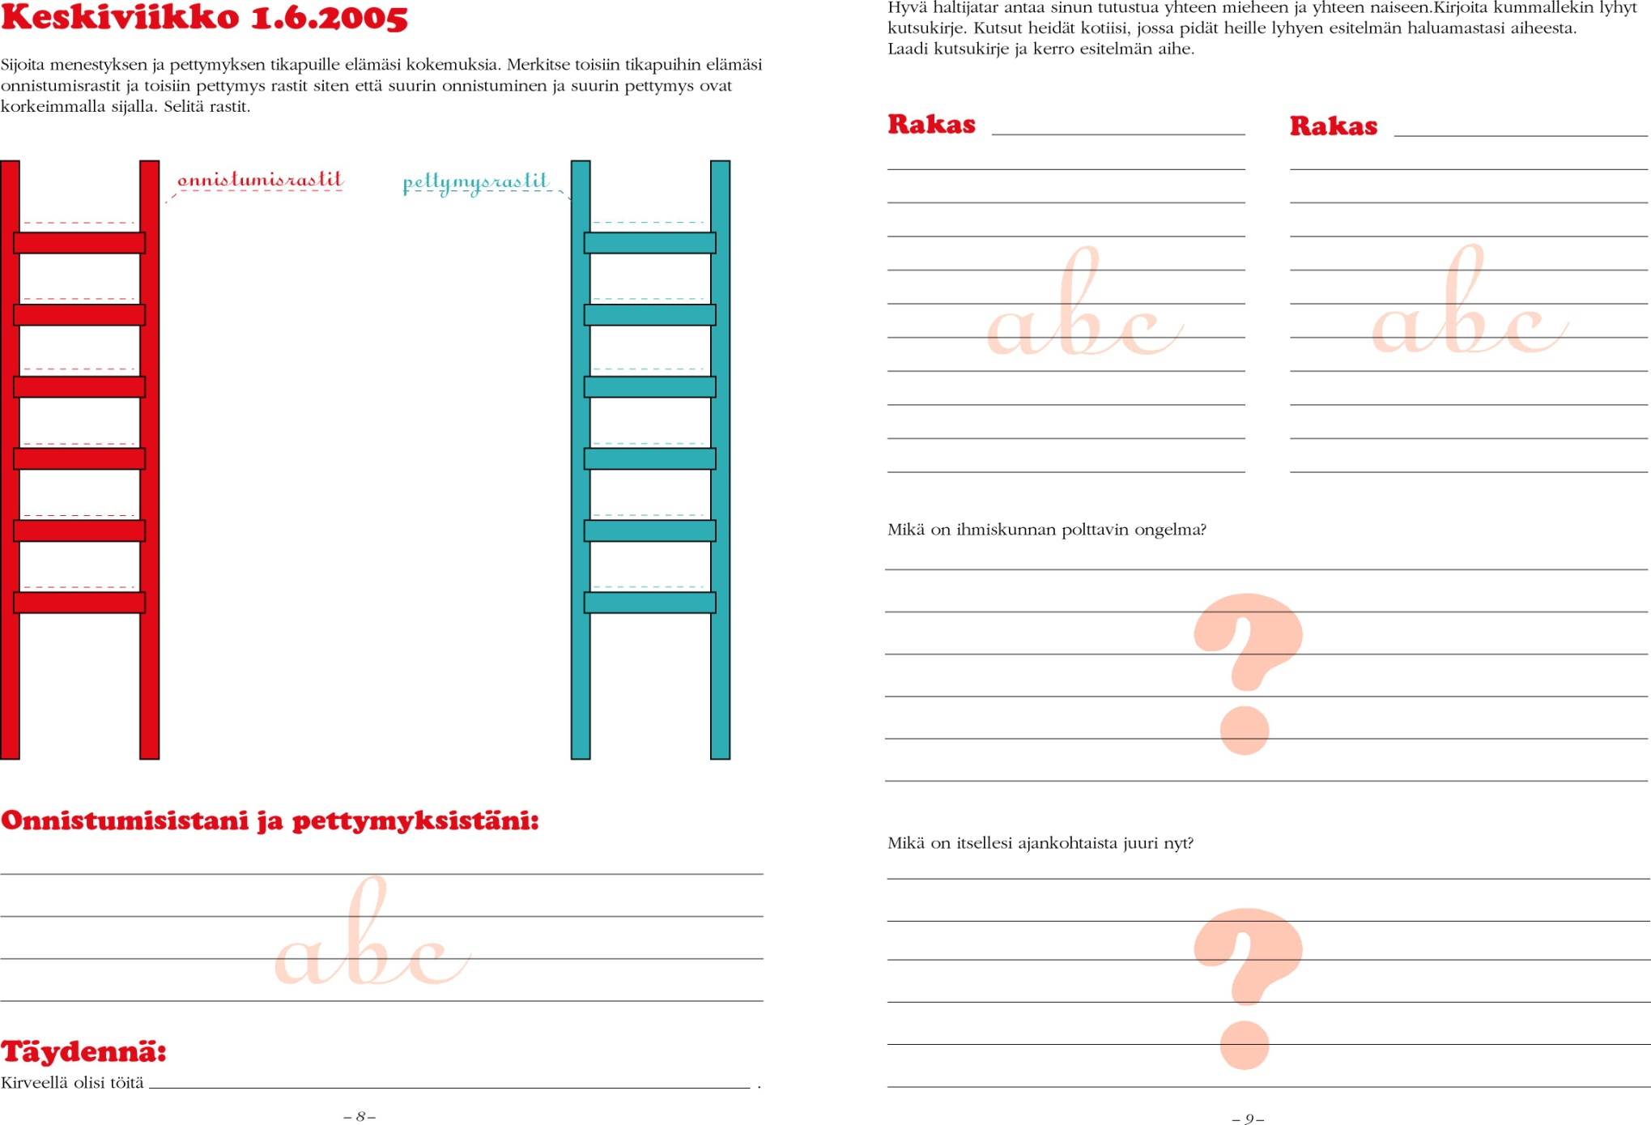
1
1.User insight projects –
’Settling down to hear’
Ajankohtaisohjelmien luotaintehtehtäväkirjasta
33

Slide 34
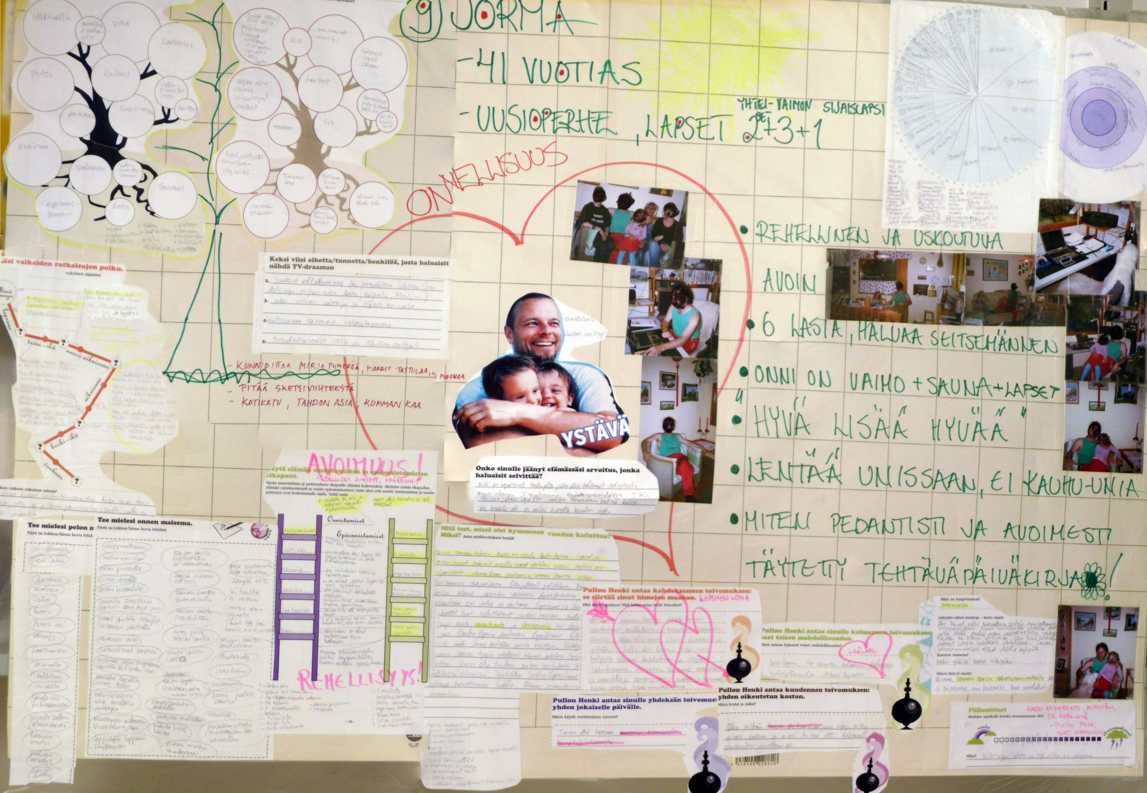
34

Slide 35
Content Probe process in a nutshell
1. Creating 10-12 fictional demographig key characters who we don’t understand
2. Finding real ones
3. Creating exercise book for 10 days, 60 exercises
4. Probe character have books at home, writing, drawing, photographing etc.
5. Returning books and cameras
6. Makers analyse the material in associative process – new questions
7. Each maker visits one character, discusses and photographs – sharpening the interpetation about the person
8. Creation of life maps, an interpretation what is essential
9. Content developement workshops based on material

Slide 36
TEST
Share the prototype idea with your users to get feedback.
What worked?
What didn’t?
Why?
I’ve made
the first draft.
Where do I take it
from here?

Slide 37
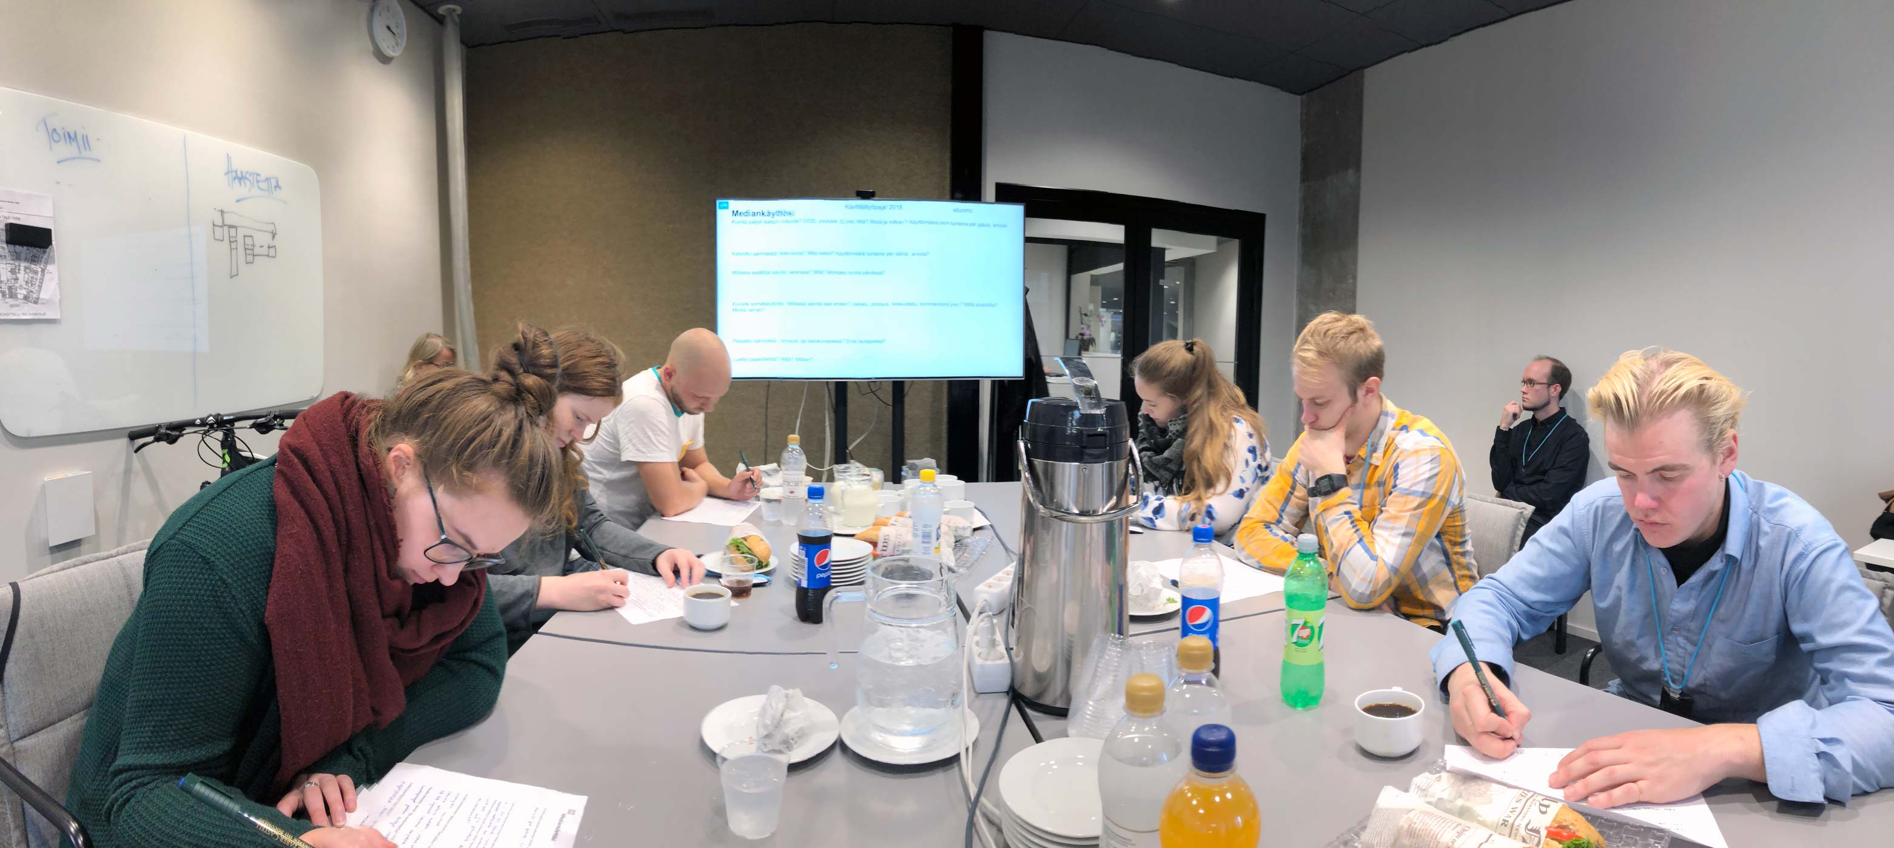
.. To develop professionally through understanding users
USER WORKSHOPS

Slide 38
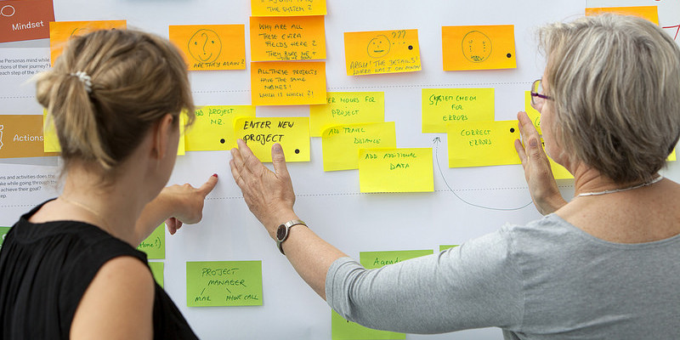
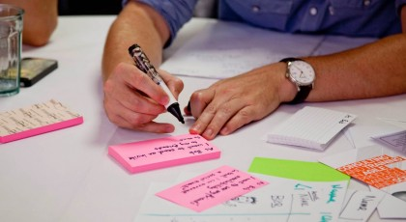
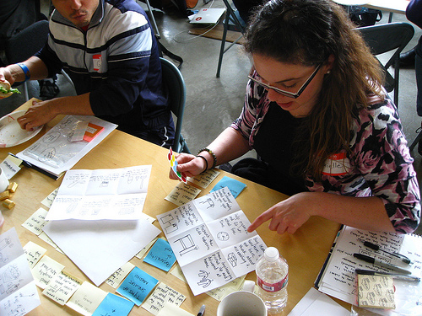
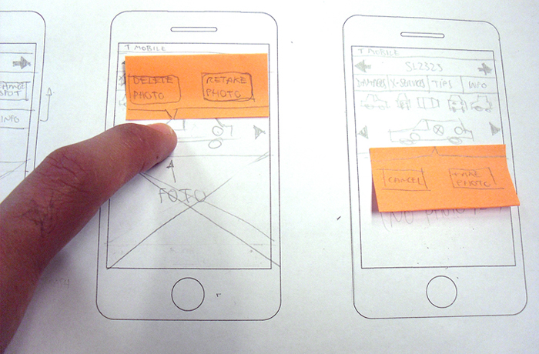
to validate developement work together with target users
USER WORKSHOPS
Concept creators, 8 target users and a facilitator
2 hours
5-7 crucial elements presented by creators through any relevant prototype means: theme, characters, storyline, metatext=motivation, audiovisual style etc.
All elements reviewed and redeveloped with users
Best learnings taken to make the content better!

Slide 39
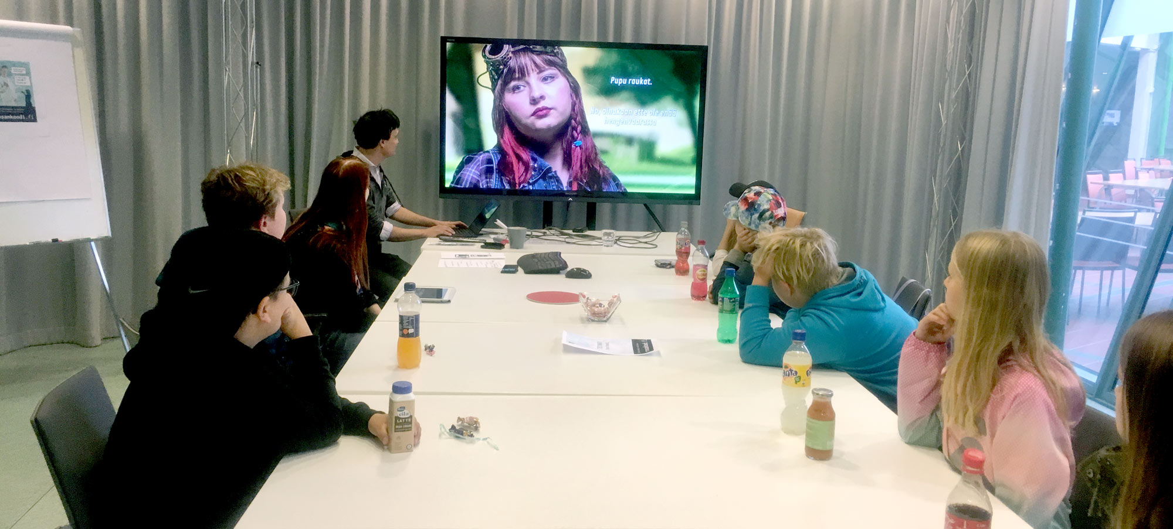
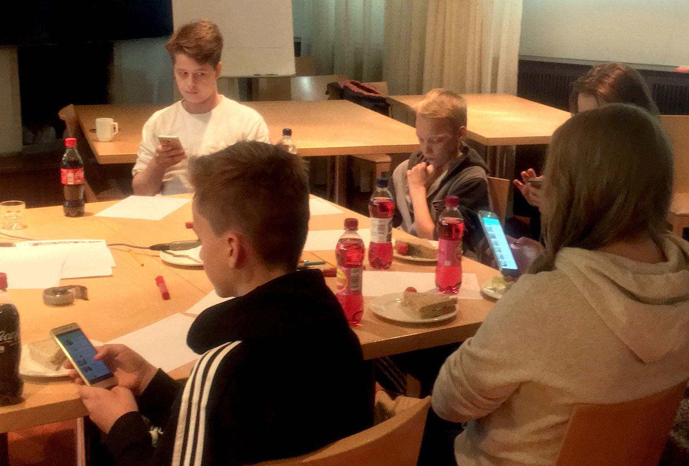
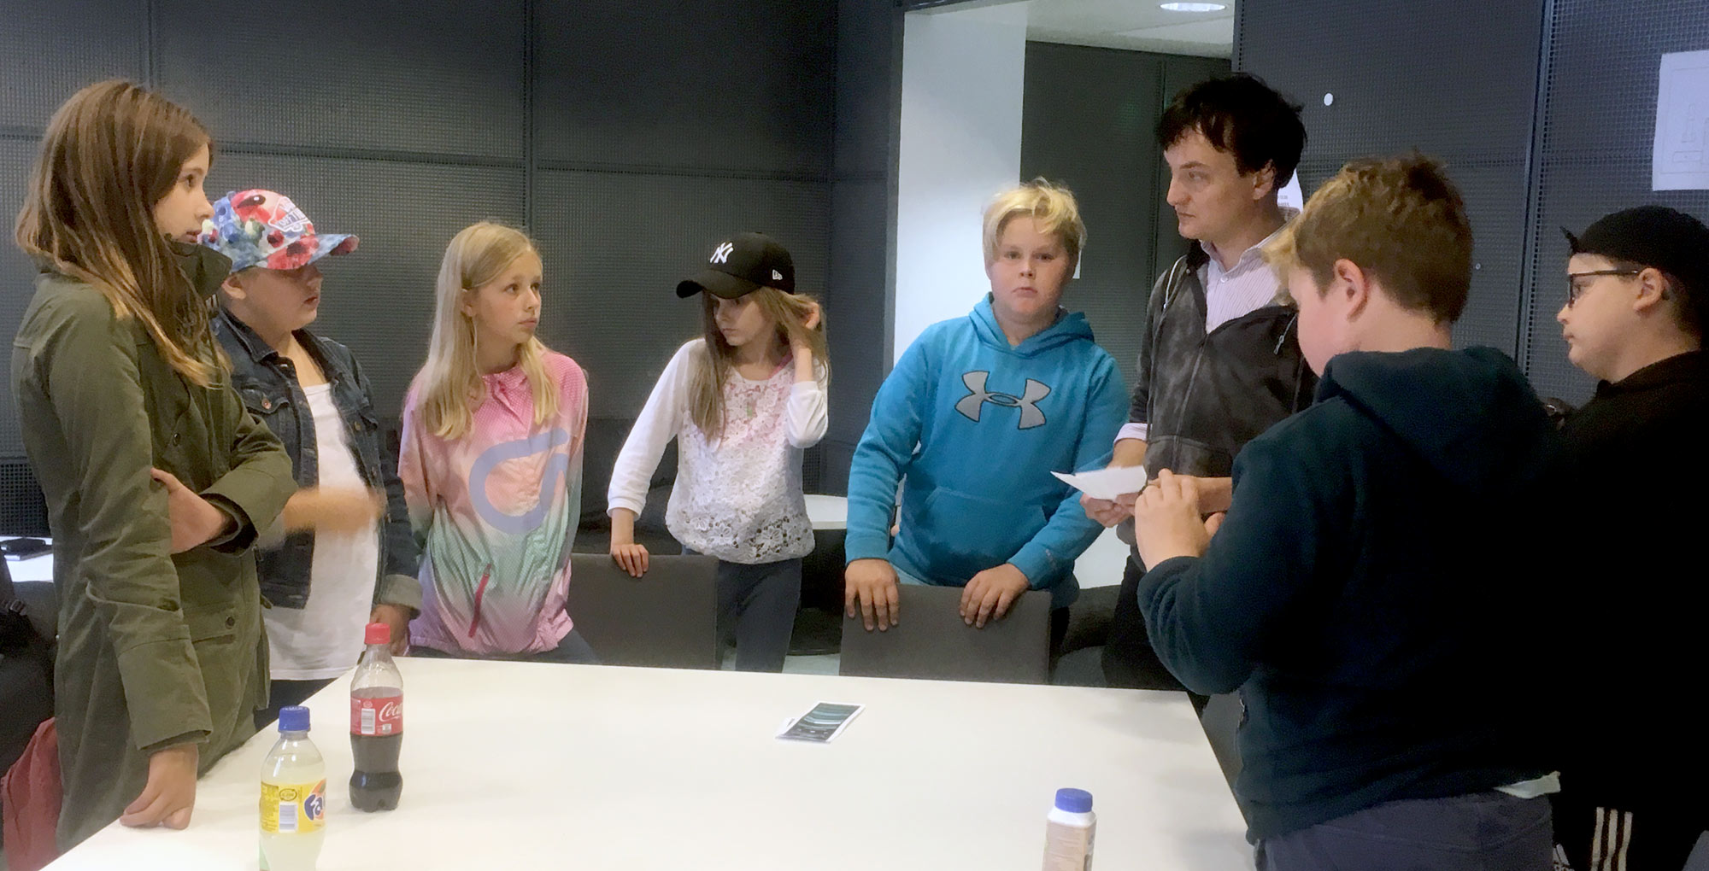
USER WORKSHOPS – WHY?
WHAT?
Makers test project plans with core users.
Facilitator takes care of the method.
WHY?
To ensure that key subject and narrative work.
To take controlled risks and avoid unexpected pitfalls.

Slide 40
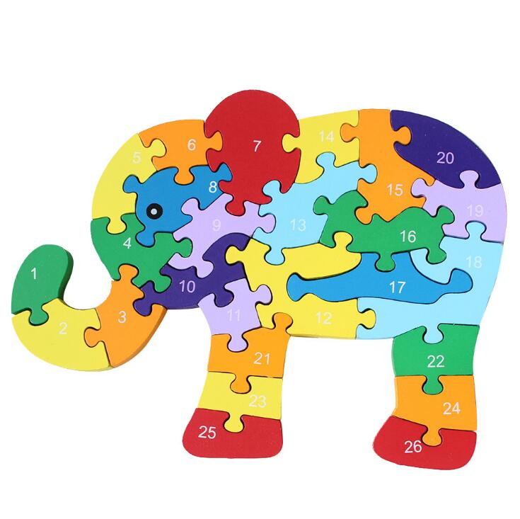

CREATIVE BUT PRECISE AND SYSTEMATIC WORK
Identify key areas/elements of the project + create alternative solutions so that users can choose & argument

Slide 41
.. To renew professional skills and approach..
WRITER / MAKER
PARTICIPATION

Slide 42
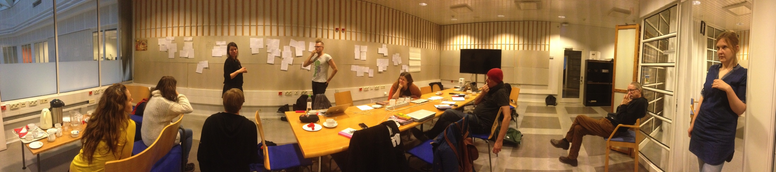
to make international high end drama with finnish local flavour – UNDER 30
COMEDY PROJECT 2017-18
8 prominent young generation comedy writers
One year / 2 days a month
8 guests giving them tools and viewpoints to see hidden change, embarrassment and pain in changing society: anthropology, psychology, social media behavior, future research etc.
9 most prominent comedy series analyzed from writers point of view
Step-by-step development of writer teams and concepts

Slide 43
to make international high end drama with finnish local flavour – UNDER 30
CRIME PROJECT 2015-16
8 prominent young generation drama writers
One year / 2 days a month
12 guests directly from grassroots: police, criminals, sociologists, sex worker aid center, crime writers, therapists,
10 most prominent crime series analyzed from writers point of view
Step-by-step development of writer teams and concepts

Slide 44

THANK YOU!
Raimo Lang raimolang@gmail.com
Head of Development, Yle Creative Content

Slide 45
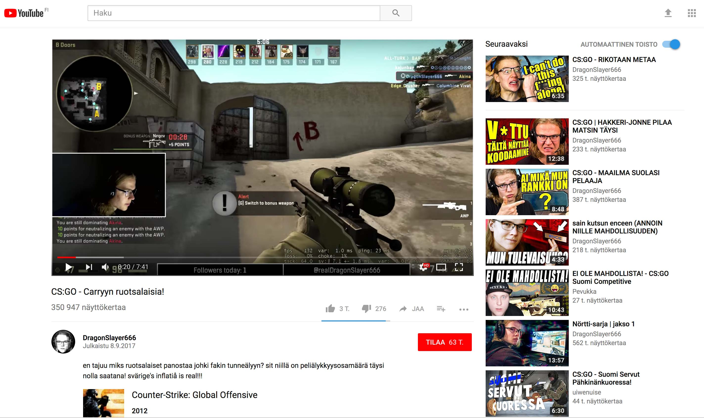
Example: Dragonslayer666
MEDIATUOTTEEN KEHITYSKAARI
HAVAINNOINTI
IDEOINTI
KONSEPTIKEHITYS
KÄSIKIRJOITUS
LÖYDETTÄVYYS
SITOUTTAMINEN
TUOTANTO
JULKAISU
LÄSNÄOLO
TUOTEANALYYSI

Slide 46
Dragonslayer666: user workshops trough the process
OBSERVATION
IDEATION
CONCEPT DEVELOPMENT
SCRIPTING
REACHABILITY
ENGAGEMENT
PRODUCTION
PUBLISHING
PRESENCE
ANALYSIS
DRAMATURGY
Dramaturgityö
Dramaturgityö
USER WORKSHOPS:
Concept, factual details, engagement, publishing

Slide 47
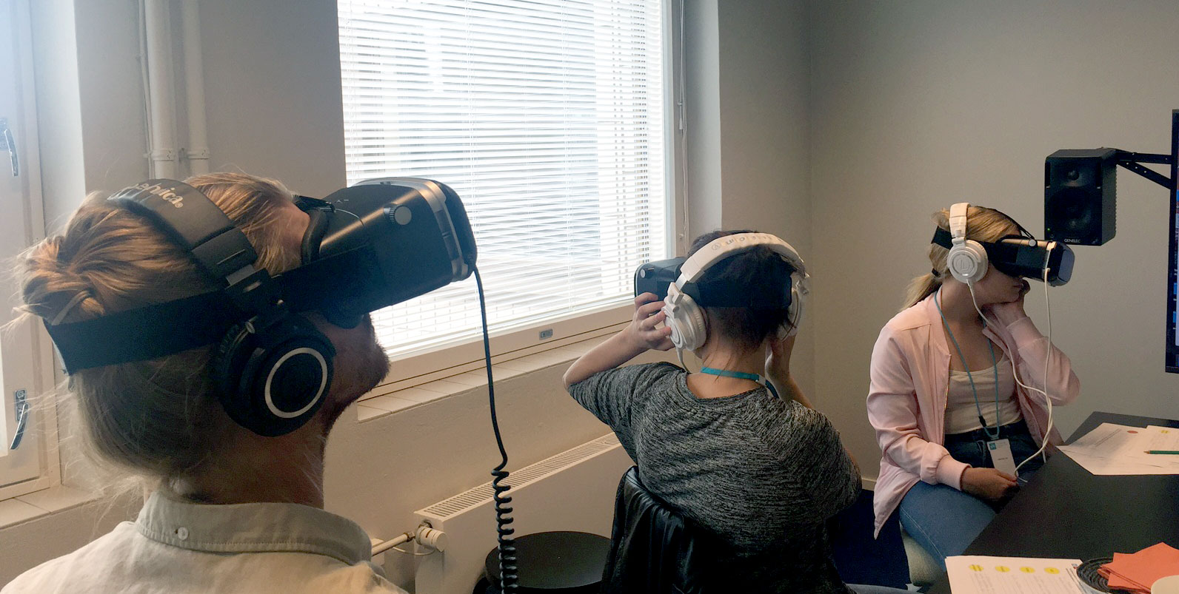
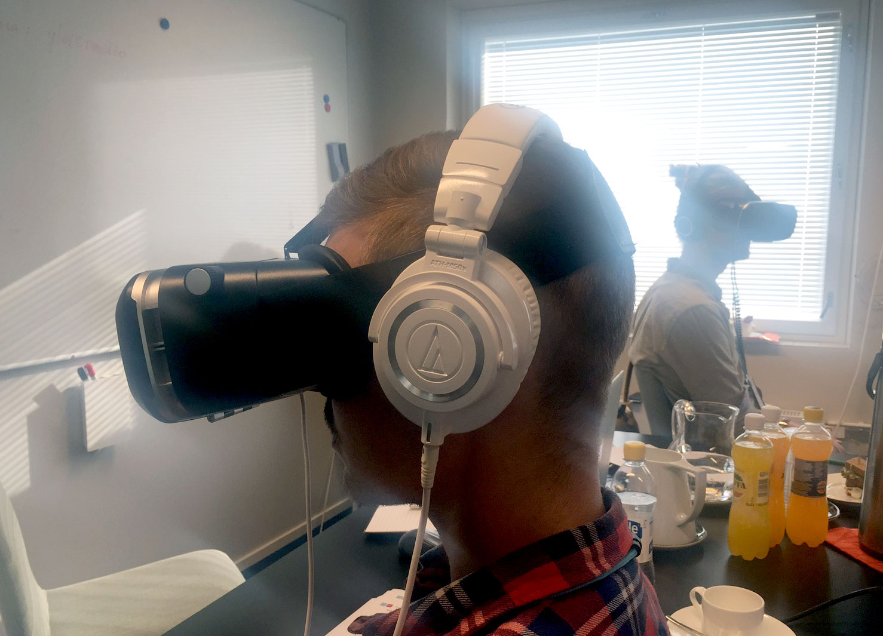
VR/360 CONTENT – YOUNG ADULT USE CASES
What it takes that 360/VR creates added value?
How VR narrative influences user experience?
21082017 / Yle Lab

Slide 48
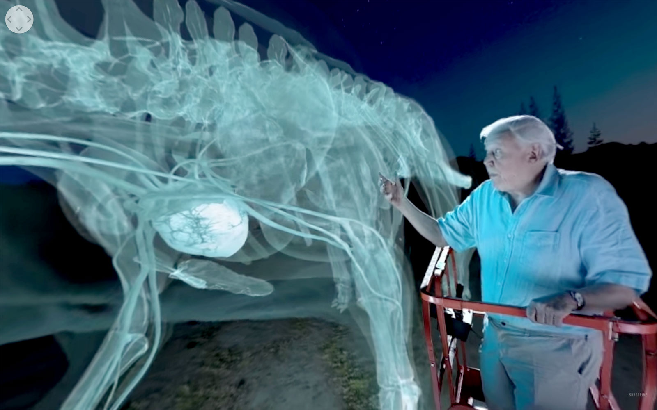
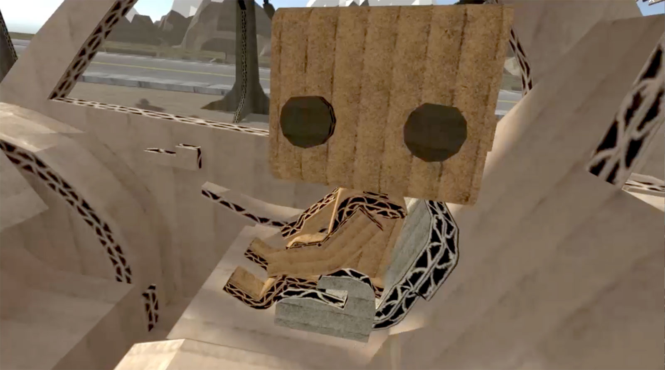
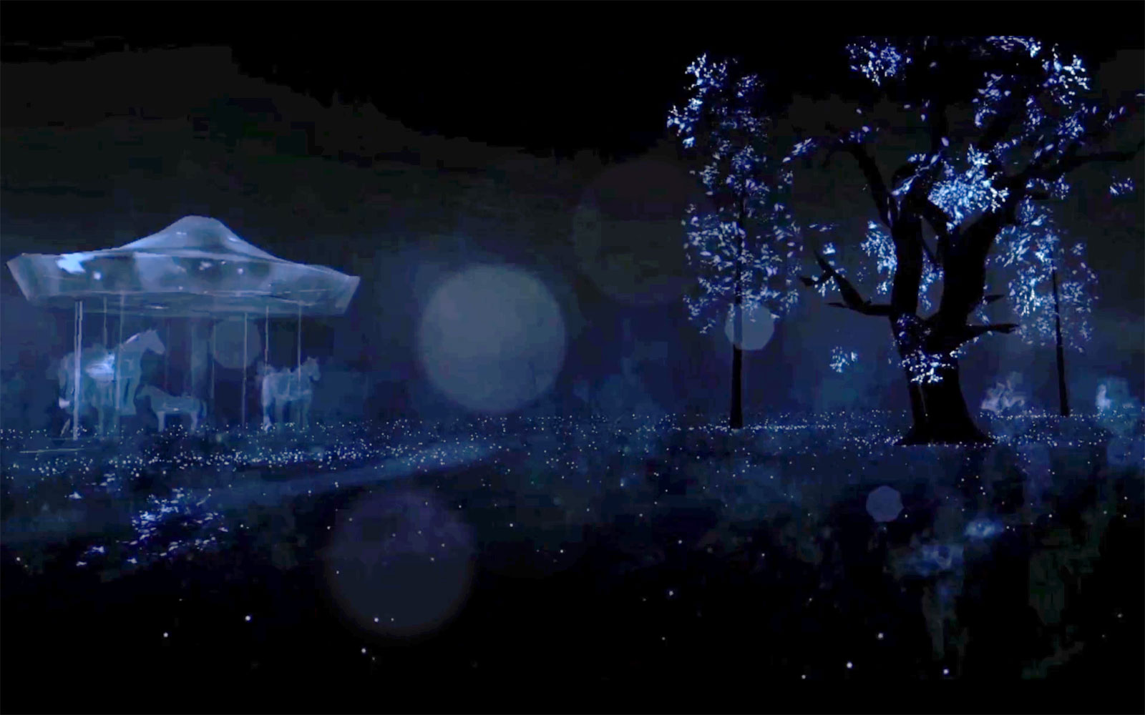
EXAMPLES
Kioski / Aleppo-Helsinki:
http://teatimeresearch.com/aleppo-helsinki/
2. BBC / Attenborough & dinosaurs: https://www.youtube.com/watch?v=rfh-64s5va4
3. Stranger things 360: https://www.youtube.com/watch?v=AqdMGaGofow
4. Notes on Blindness: http://www.notesonblindness.co.uk/vr/ - DOWNLOADED
5. Cardboard crash / Sundance edition: appstore & googleplay = cardboardcrash
https://play.google.com/store/apps/details?id=ca.nfb.cardboardcrash.sundance - DOWNLOADED

Slide 49
User workshop / VR / 21082017
Imagine this content made to different mediums. What would be most / least interesting for you?
Mark: 1 = most interesting 4 = least interesting. Tell why?
VR
Video
Podcast
Written story

Slide 50
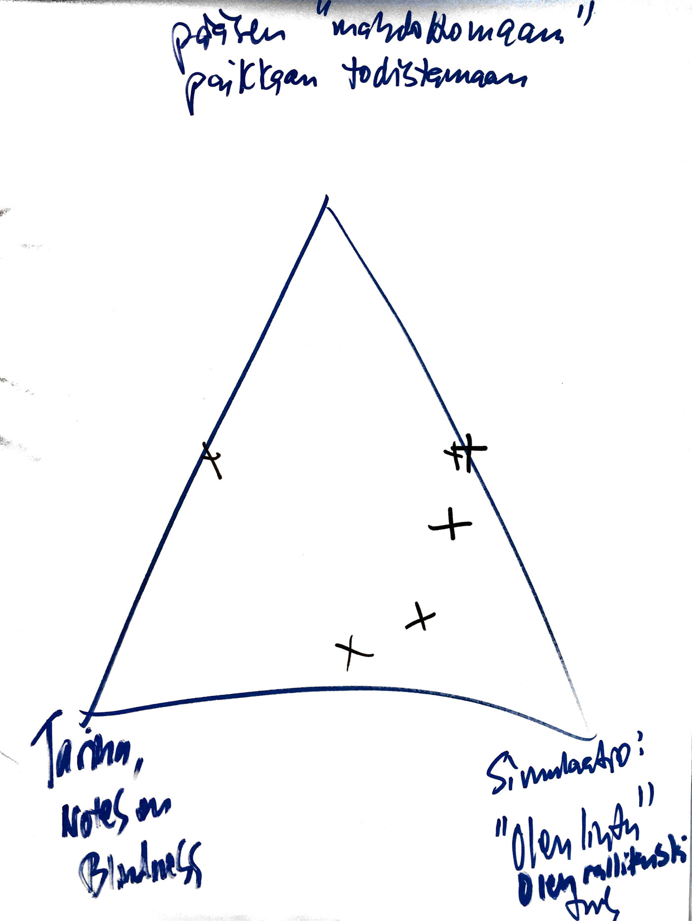
What type of VR narrative interests most?
Being an observer is not interesting
Mix of ’impossible simulation’ and story is promising
Interactivity is a must
Sound can be better starting point
I can observe the impossible?
Storytelling: I’m in the middle
Simulation: I’m a bird

Slide 51
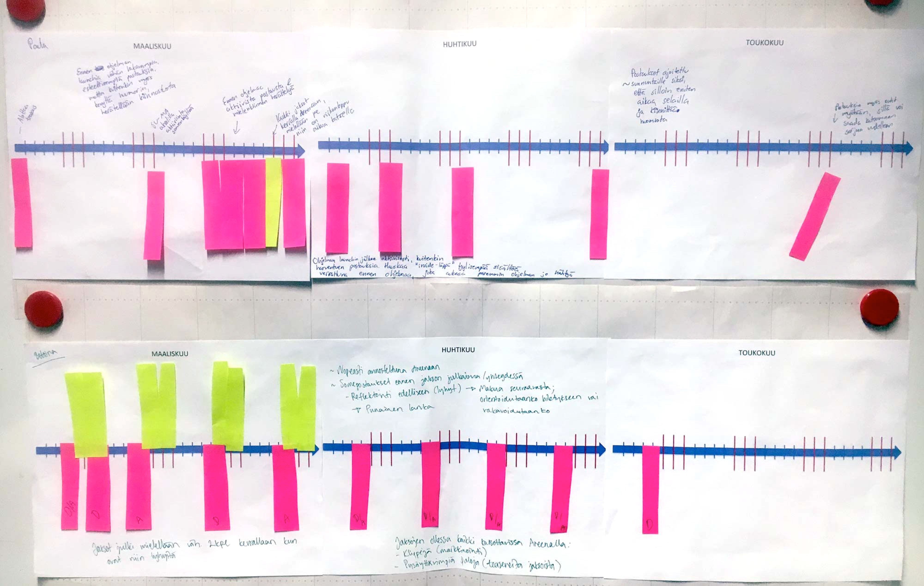
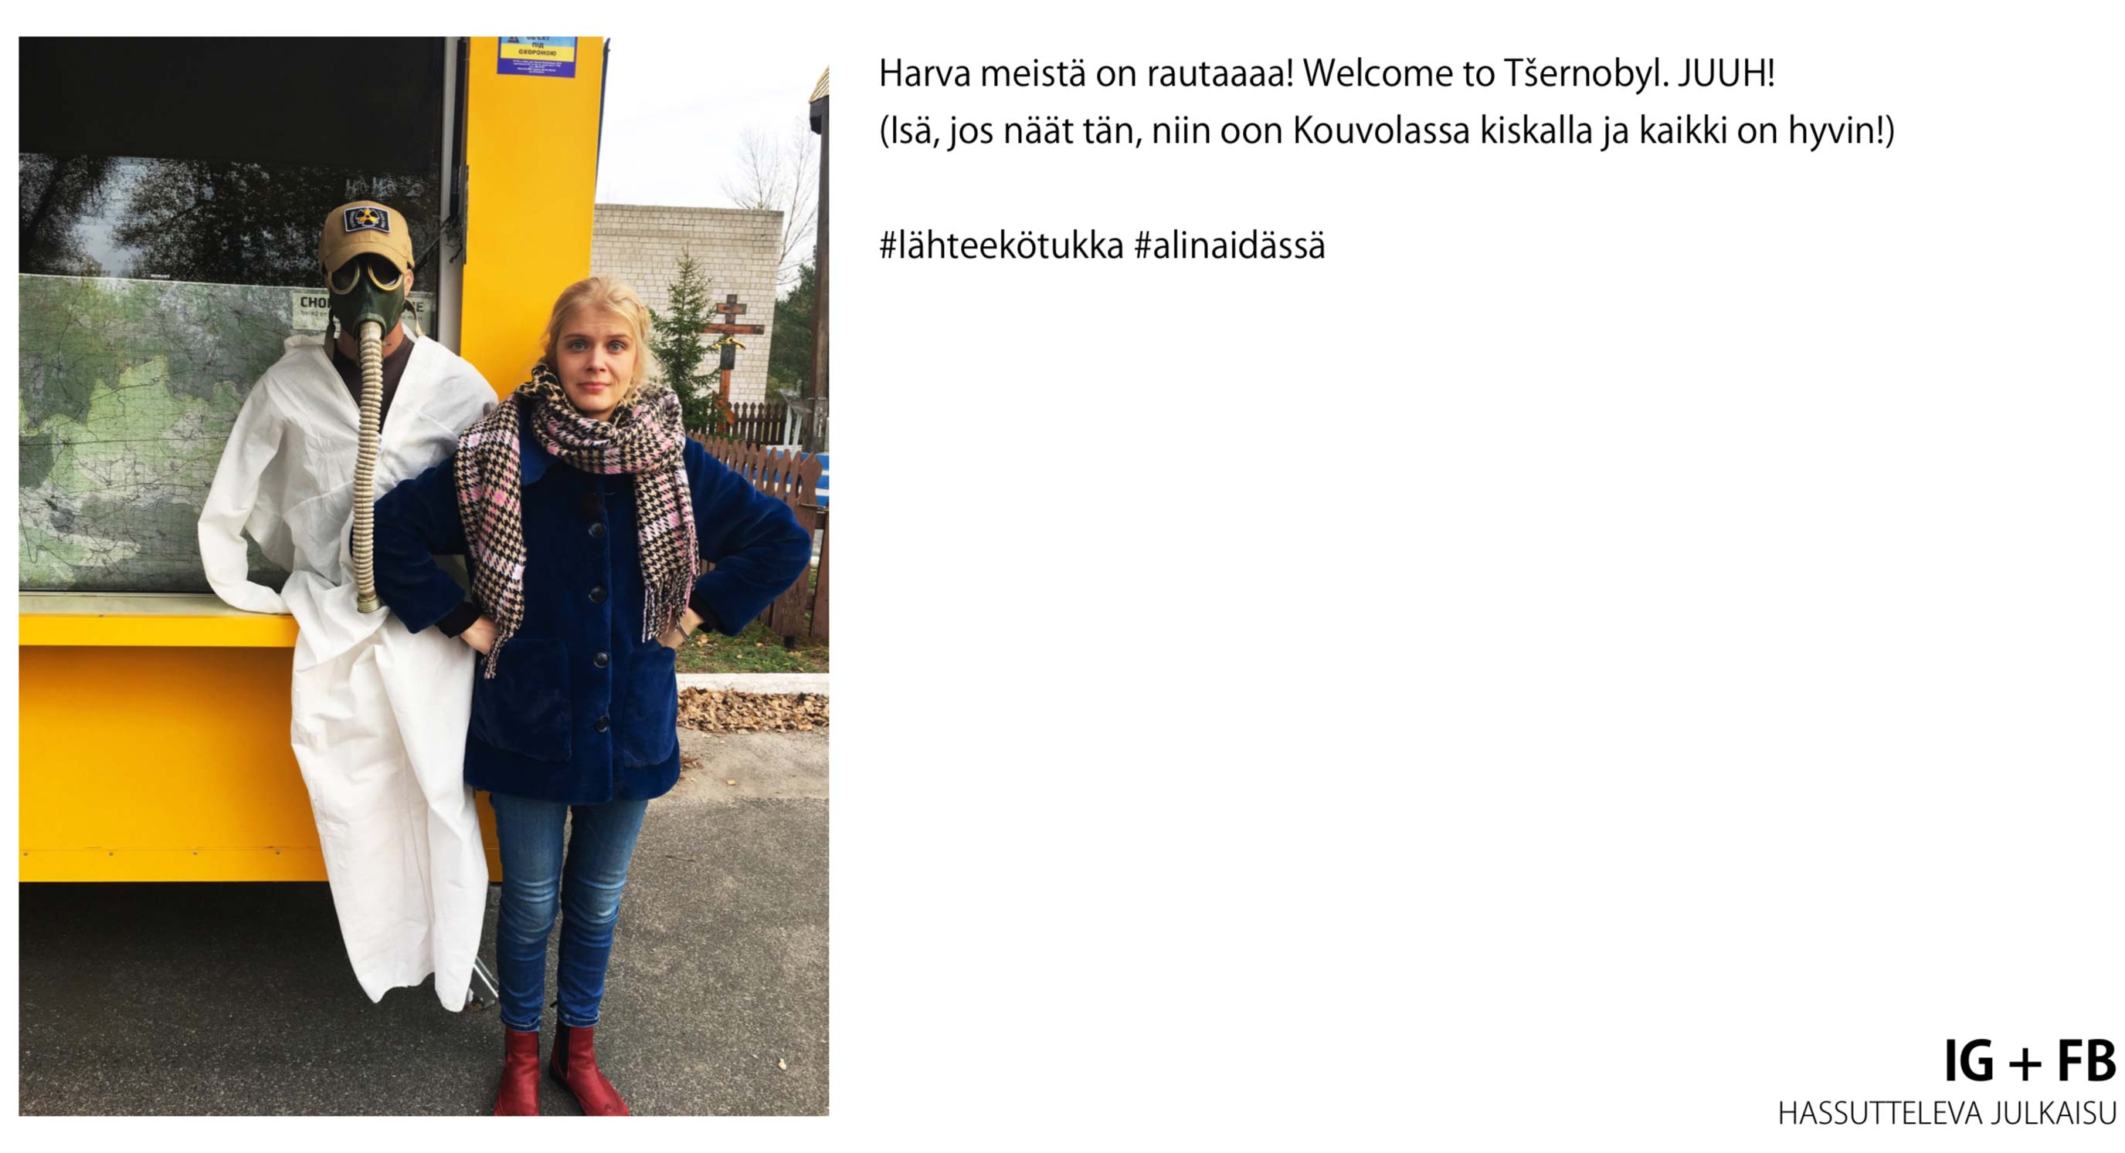
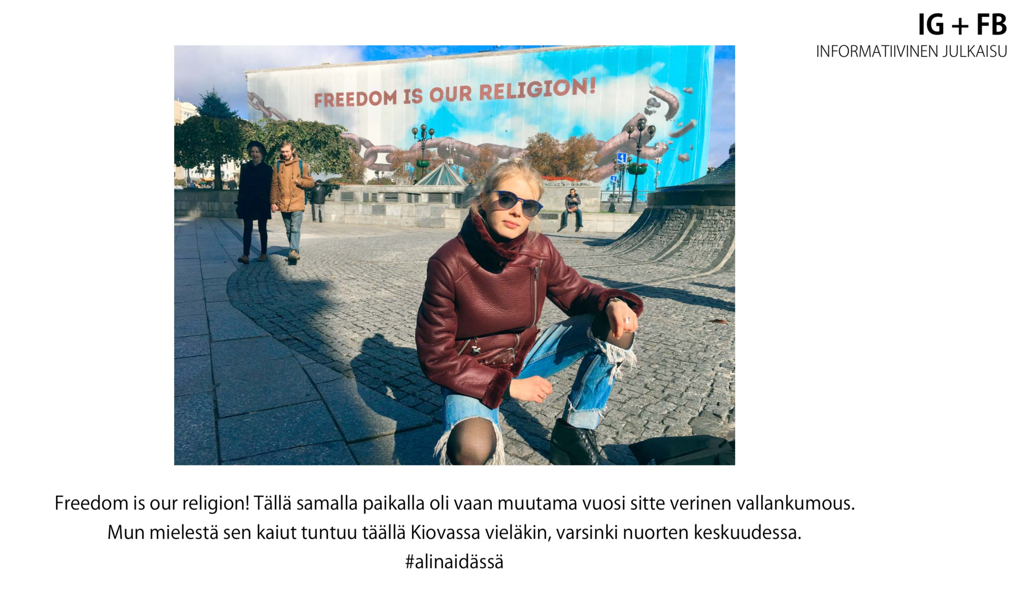
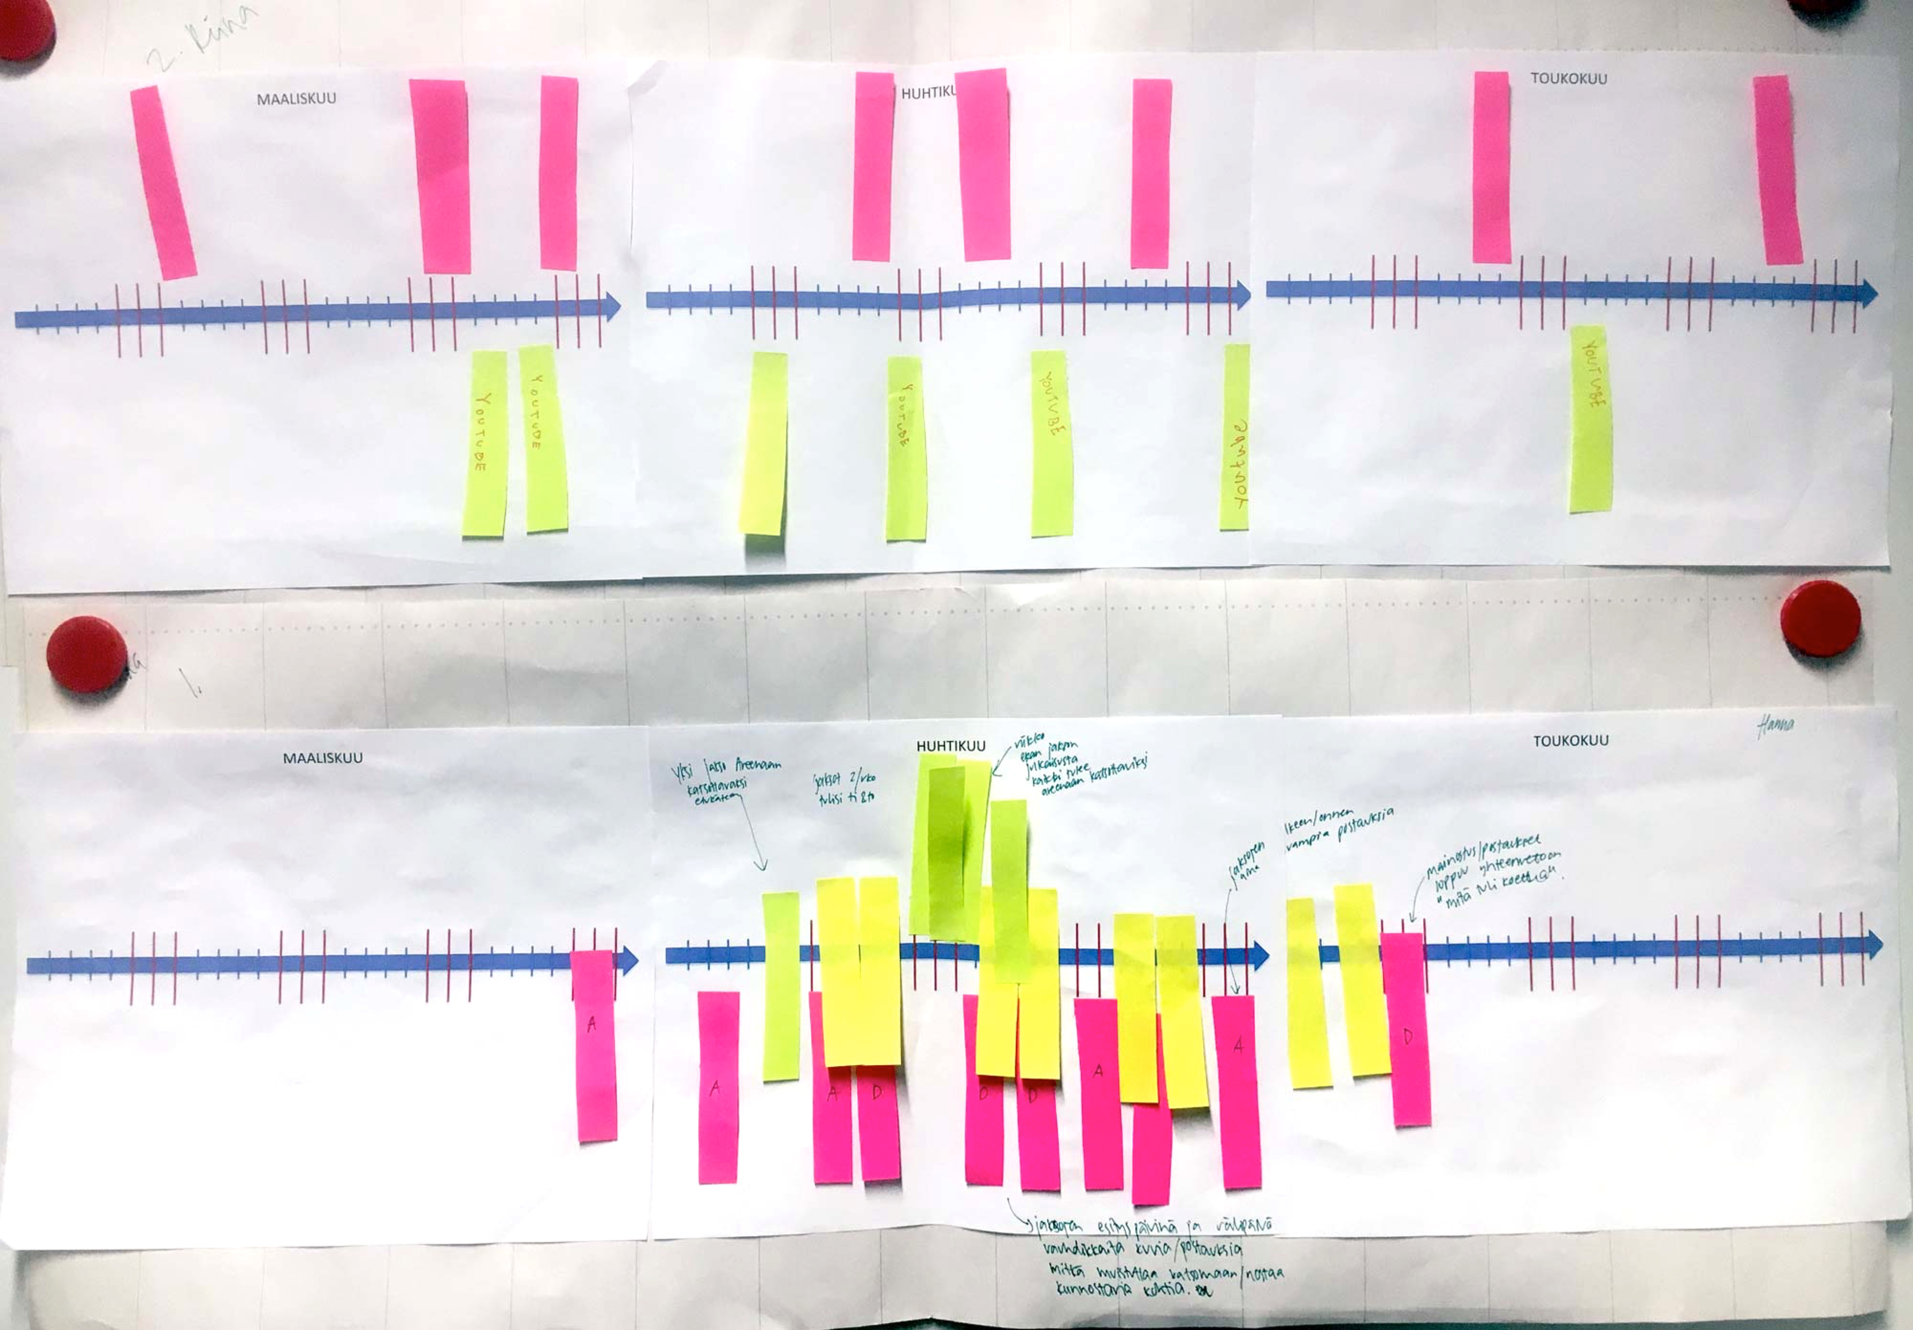
Example: Alina ja Travels to East

